Slide 1

Docker Basics

Slide 2
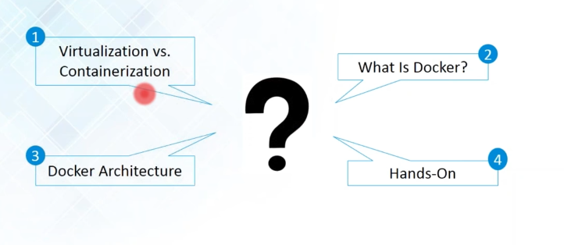
Course Topics

Slide 3
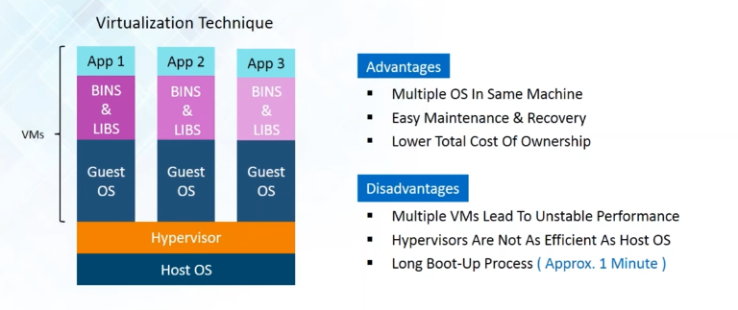
Virtualization

Slide 4
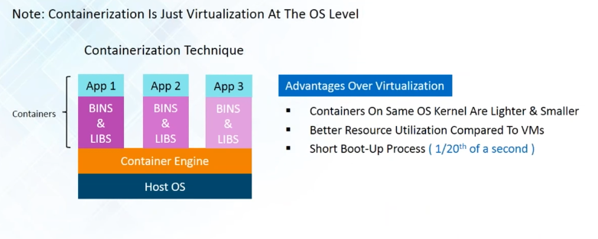
Containerization

Slide 5
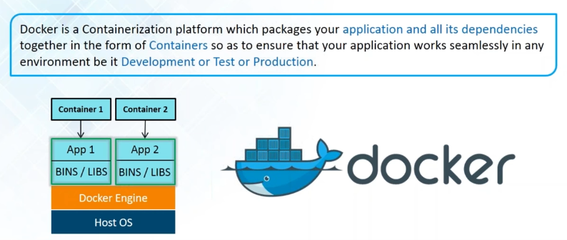
Docker

Slide 6
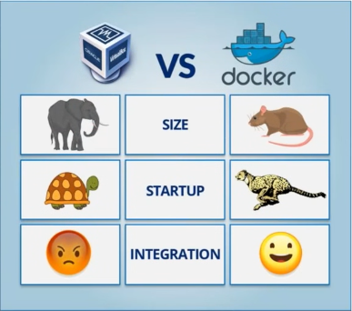
VM vs. Docker

Slide 7
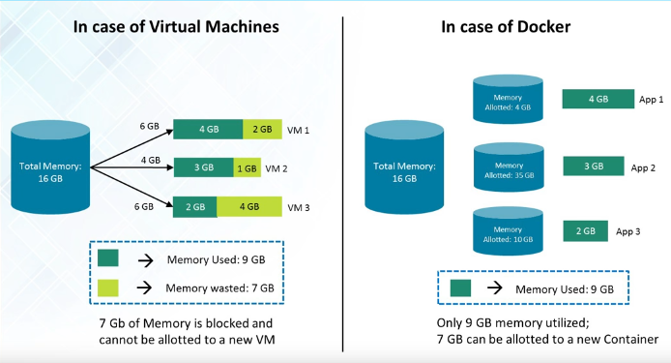
Resource/Memory Utilization

Slide 8
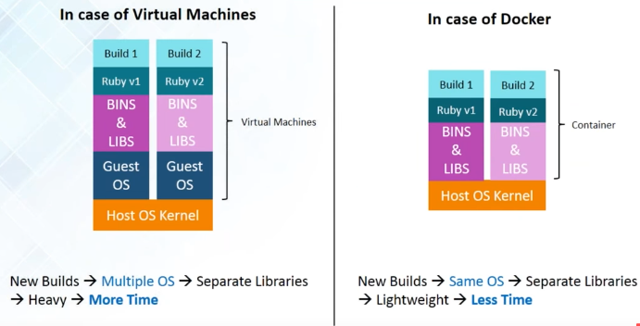
Building & Deployment

Slide 9
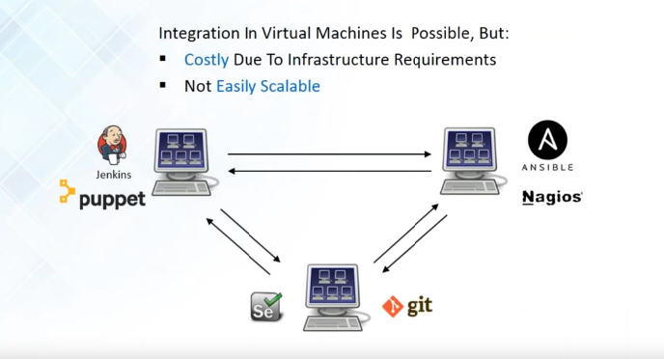
Integration in VMs

Slide 10
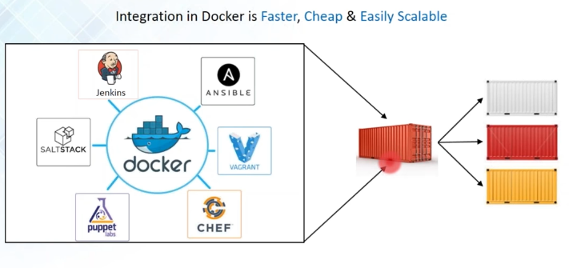
Docker - A Devops ally

Slide 11
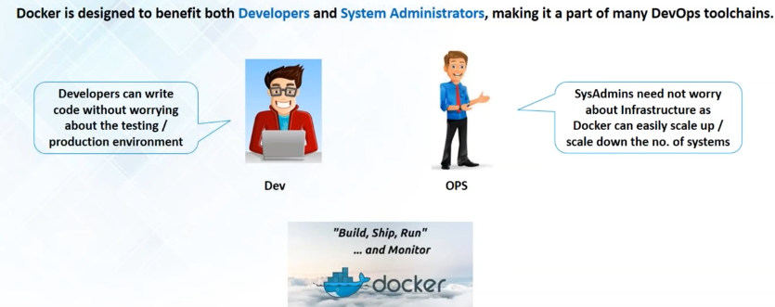
Who Can Use Docker

Slide 12
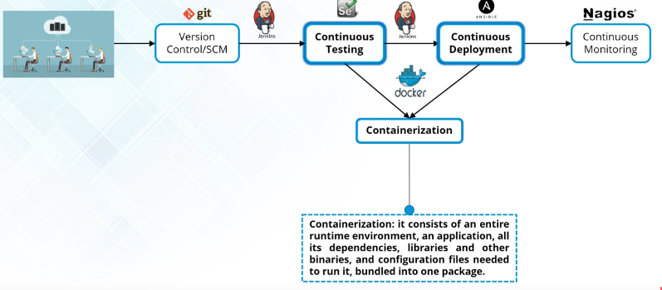
How is Docker Used In Devops

Slide 13
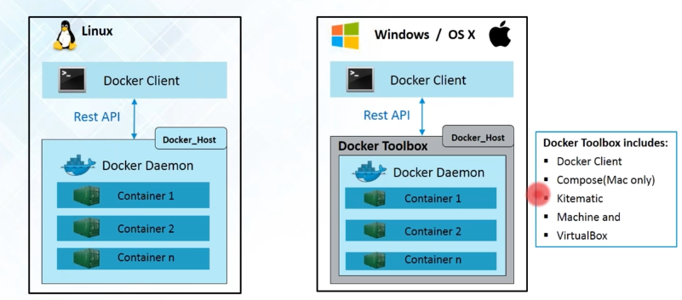
Docker Engine

Slide 14
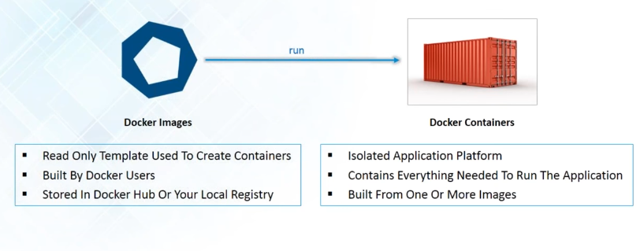
Docker Images & Containers

Slide 15
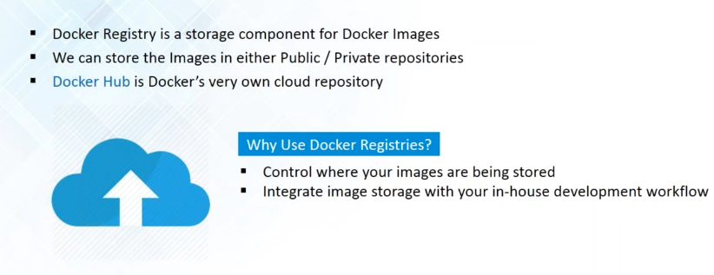
Docker Registry

Slide 16
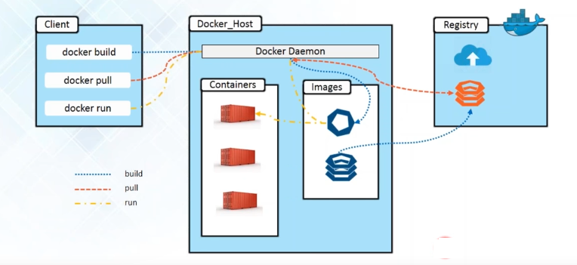
Docker Architecture

Slide 17
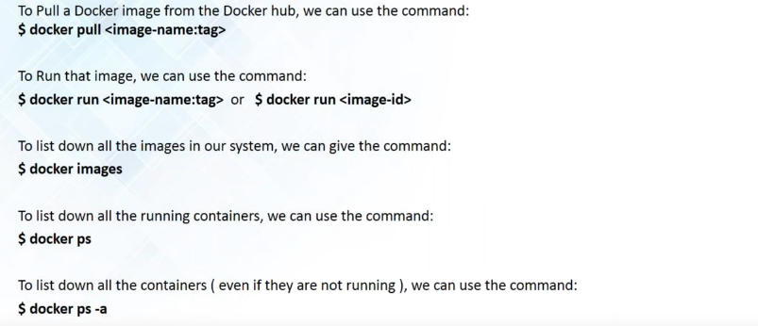
Basic Docker Commands

Slide 18
Docker Hello world Demo
Hands-On
Notes:
18

Slide 19
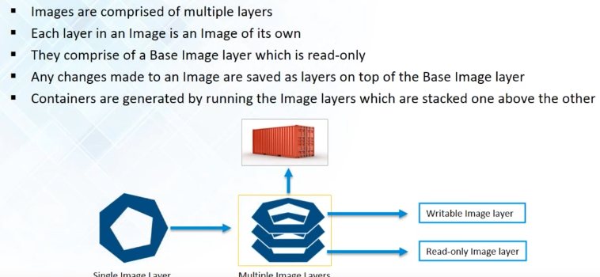
Building Images

Slide 20
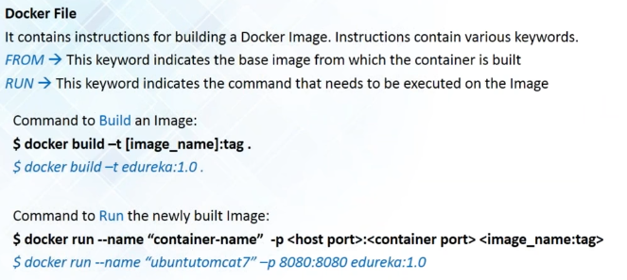
Creating Docker File

Slide 21
Docker Build
Hands-On
Notes:
21

Slide 22
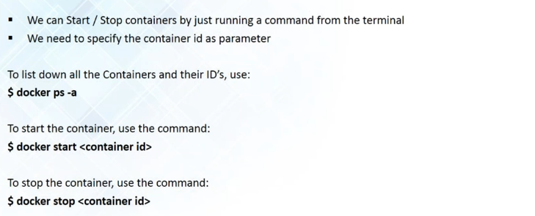
Start /Stop Container

Slide 23
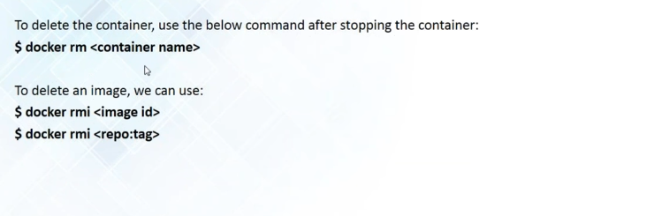
Deleting Containers / Images

Slide 24
Deleting Containers / Images

Slide 25
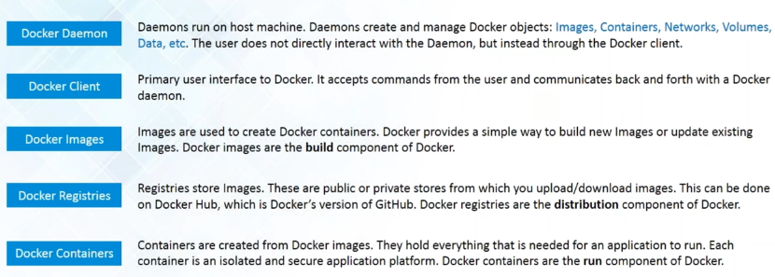
Docker Terminology

Slide 26
Session Summary
Image Creation | Image Management | Container Management | Information
commit | search | run | info
build | pull | stop
 | images | start
 | push | kill
 | rmi | ps
 | history | top
 |  | exec
 |  | attach
 |  | rm
 |  | logs

Slide 27
